Slide 1
RE identities and Arden’s Theorem

Slide 2
Given R, P, L, Q as regular expressions, the following identities hold −
∅* = ε
ε* = ε
RR* = R*R
R*R* = R*
(R*)* = R*
RR* = R*R
(PQ)*P =P(QP)*
(a+b)* = (a*b*)* = (a*+b*)* = (a+b*)* = a*(ba*)*
R + ∅ = ∅ + R = R (The identity for union)
R ε = ε R = R (The identity for concatenation)
∅ L = L ∅ = ∅ (The annihilator for concatenation)
R + R = R (Idempotent law)
L (M + N) = LM + LN (Left distributive law)
(M + N) L = ML + NL (Right distributive law)
ε + RR* = ε + R*R = R*

Slide 3
Arden’s Theorem
In order to find out a regular expression of a Finite Automaton, we use Arden’s Theorem along with the properties of regular expressions.
Statement −
Let P and Q be two regular expressions.
If P does not contain null string, then R = Q + RP has a unique solution that is R = QP*

Slide 4
Proof
Proof −
R = Q + (Q + RP)P [After putting the value R = Q + RP]
= Q + QP + RPP
When we put the value of R recursively again and again, we get the following equation −
R = Q + QP + QP² + QP³…..
R = Q (ε + P + P² + P³ + …. )
R = QP*

Slide 5
Assumptions for Applying Arden’s Theorem
The transition diagram must not have NULL transitions
It must have only one initial state

Slide 6
Method
Step 1 − Create equations as the following form for all the states of the DFA having n states with initial state q₁.
q₁ = q₁R₁₁ + q₂R₂₁ + … + q_{n}R_{n1} + ε
q₂ = q₁R₁₂ + q₂R₂₂ + … + q_{n}R_{n2}
…………………………
…………………………
…………………………
…………………………
q_{n} = q₁R_{1n} + q₂R_{2n} + … + q_{n}R_{nn}
R_{ij} represents the set of labels of edges from q_{i} to q_{j}, if no such edge exists, then R_{ij} = ∅

Slide 7
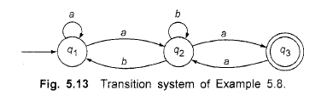
Step 2 − Solve these equations to get the equation for the final state in terms of R_{ij}
_{Example:}

Slide 8
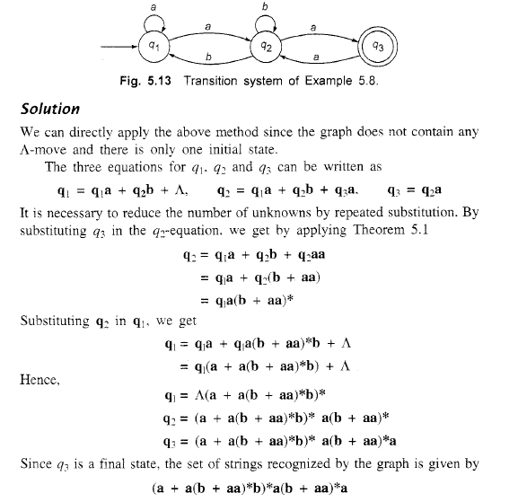

Slide 9

Example of Arden’s theorem
Q1: Construct the regular expression for the given DFA
Solution:
Let us write down the equations
q1 = q1 0 + ε
Since q1 is the start state, so ε will be added, and the input 0 is coming to q1 from q1 hence we write State = source state of input × input coming to it
Similarly,
q2 = q1 1 + q2 1 q3 = q2 0 + q3 (0+1)

Slide 10
Example of Arden’s theorem
Since the final states are q1 and q2, we are interested in solving q1 and q2 only. Let us see q1 first
q1 = q1 0 + ε
We can re-write it as
q1 = ε + q1 0
Which is similar to R = Q + RP, and gets reduced to R = OP*.
Assuming R = q1, Q = ε, P = 0
We get
q1 = ε.(0)* q1 = 0* (ε.R*= R*)
Substituting the value into q2, we will get
q2 = 0* 1 + q2 1 q2 = 0* 1 (1)* (R = Q + RP → Q P*)
The regular expression is given by
r = q1 + q2 = 0* + 0* 1.1* r = 0* + 0* 1⁺ (1.1* = 1⁺)

Slide 11
Example of Arden’s theorem
Q2:Find regular expression for the following DFA using Arden’s Theorem-
Solution-
Step-01:
Form a equation for each state-
q1 = ∈ ……(1)
q2 = q1.a ……(2)
q3 = q1.b + q2.a + q3.a …….(3)
Step-02:
Bring final state in the form R = Q + RP.
Using (1) in (2), we get-
q2 = ∈.a
q2 = a …….(4)

Slide 12
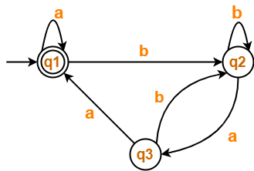
Example of Arden’s theorem
Using (1) and (4) in (3), we get-
q3 = q1.b + q2.a + q3.a
q3 = ∈.b + a.a + q3.a
q3 = (b + a.a) + q3.a …….(5)
Using Arden’s Theorem in (5), we get-
q3 = (b + a.a)a*
Thus, Regular Expression for the given DFA = (b + aa)a*
Q3: Find regular expression for the following DFA using Arden’s Theorem-

Slide 13
Example of Arden’s theorem
Step-01:
Form a equation for each state-
q1 = ∈ + q1.a + q3.a ……(1)
q2 = q1.b + q2.b + q3.b ……(2)
q3 = q2.a …….(3)
Step-02:
Bring final state in the form R = Q + RP.
Using (3) in (2), we get-
q2 = q1.b + q2.b + q2.a.b
q2 = q1.b + q2.(b + a.b) …….(4)
Using (3) in (2), we get-
q2 = q1.b + q2.b + q2.a.b
q2 = q1.b + q2.(b + a.b) …….(4)

Slide 14
Example of Arden’s theorem
Using (5) in (3), we get-
q3 = q1.b.(b + a.b)*.a …….(6)
Using (6) in (1), we get-
q1 = ∈ + q1.a + q1.b.(b + a.b)*.a.a
q1 = ∈ + q1.(a + b.(b + a.b)*.a.a) …….(7)
Using Arden’s Theorem in (7), we get-
q1 = ∈.(a + b.(b + a.b)*.a.a)*
q1 = (a + b.(b + a.b)*.a.a)*
Thus, Regular Expression for the given DFA = (a + b(b + ab)*aa)*

